Slide 1
-
-
-

Slide 4


Market Size

Slide 5
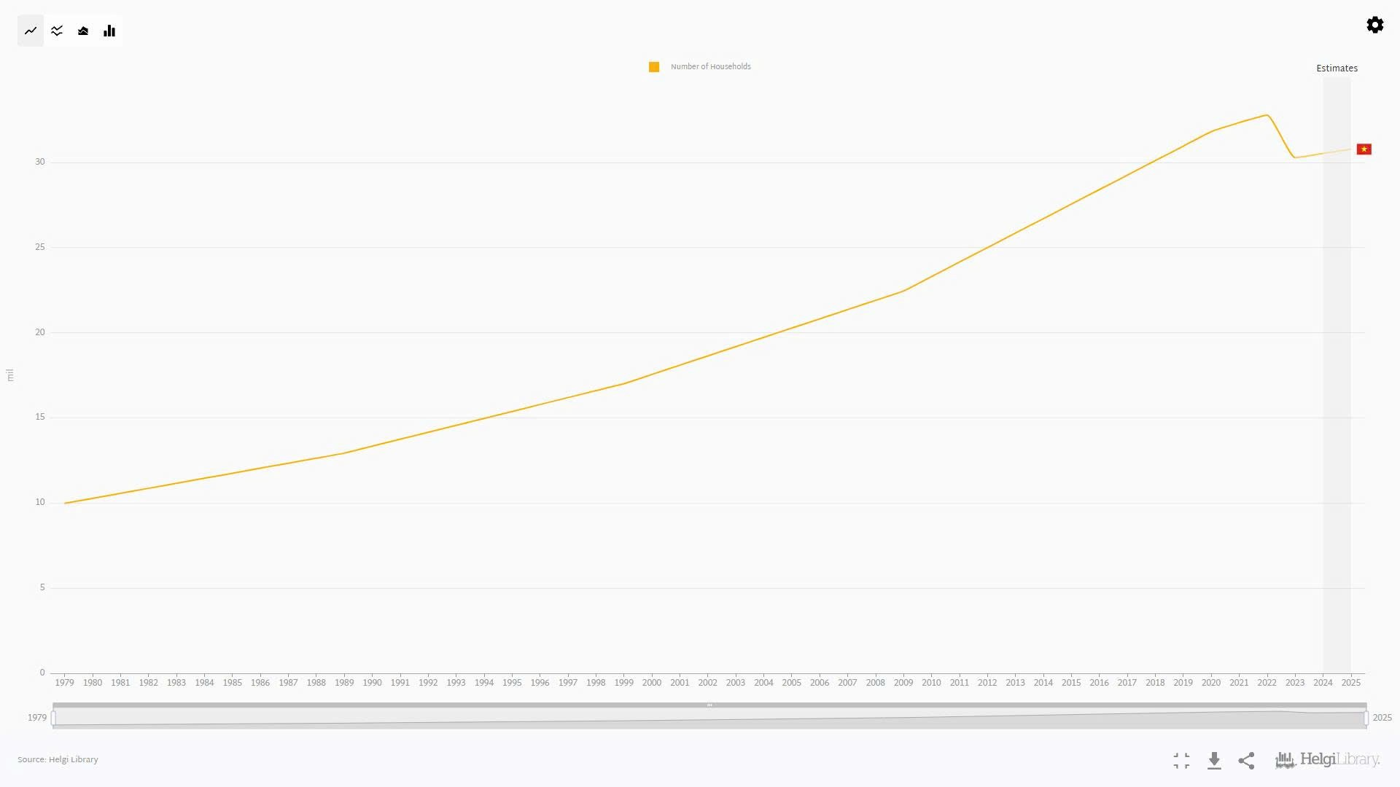
Market Validation
Why the Home Appliance Repair Market is Growing
Vietnam has nearly 30 million households, most owning essential appliances like air conditioners, washing machines, and refrigerators.
Modern appliances are more complex and less durable, making self-repair difficult.
This creates a steady demand for professional repair services.

Slide 7


Slide 10
Market Size

Slide 12
Market Size

Slide 15


